Slide 1
    Fuzzy Databases
Dr. A.C.S Rao
Department of Computer Science and Engineering
Indian Institute of Technology (ISM) Dhanbad

Slide 2
INTRODUCTION
INTELLIGENT SYSTEMS
  intended for performing more and more advanced tasks
  require to represent the world as it is (without too drastic simplifications as it is done sometimes for diverse reasons − in particular ease of computation)
  examples: databases where data are either precise, or declared as "nulls«
  output of automated object recognition or data fusion or … forced
  to be deterministic whereas it could be kept imprecise to be more
  "reality-compliant"
  must provide convenient functionalities (services), for instance expression of preferences rather than yes/no conditions

Slide 3




INTRODUCTION
THE RELATIONAL SETTING
  database = set of relations (i.e., subsets of Cartesian products of domains)
  example: shots over the schema SHOT(#s, date, place, aircraft)
#s date place aircraft
15 d1 arkhangelsk mig 31
27 d3 dolon sukhoi 27
. . . .
. . . .
. . . .

Slide 4
REMINDERS ON FUZZY SETS
INTRODUCTION
  introduced by L.A. Zadeh in 1965
  initial motivation: fuzzy classes in systems modeling (regular control)
  first applications in the mid 70's: Mamdani in UK and others in Europe
  "fuzzy boom" in Japan and its consequences all over the world, in particular the visibility of the field
  research conducted in many domains (in addition to control): mathematics, classification, artificial intelligence, information systems, decision-making, …
  basic idea: classes or sets whose boundaries are not clear-cut
  examples: young people, well-paid employees, ...

Slide 5
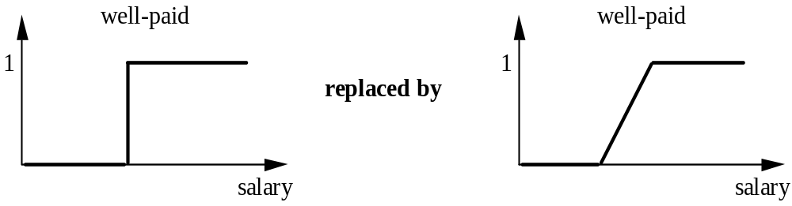
REMINDERS ON FUZZY SETS
INTEREST
  discontinuity avoidance
  gradual transition between the full membership and the exclusion
  regular sets are just special cases of fuzzy ones

Slide 6
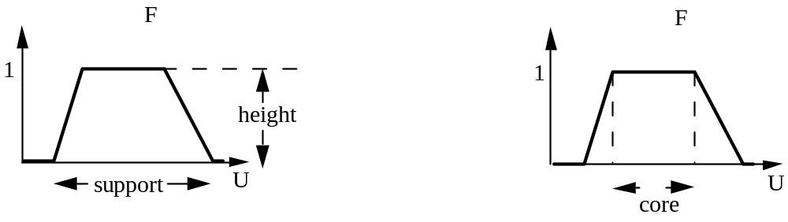
REMINDERS ON FUZZY SETS
PRINCIPAL CHARACTERISTICS
  membership function: μ_{F} (x) takes its values in [0, 1]
  support: {x | μ_{F} (x) > 0} core: {x | μ_{F} (x) = 1}
  height: sup_{x} μ_{F} (x) cardinality: card(E) = Σ_{x} μ_{F} (x)
  level-cut: F_{α} = {x | μ_{F} (x) ≥ α}

Slide 7
REMINDERS ON FUZZY SETS
OPERATIONS ON FUZZY SETS
  generalization(s) of operations defined on usual sets
  idea: to maintain as many properties as possible
SET OPERATIONS
  complement: μ_{F}c (x) = 1 - μ_{F} (x)
  intersection/union: μ_{E ∩ F} (x) = t(μ_{E} (x), μ_{F} (x)) min, *, ...
    μ_{E ∪ F} (x) = s(μ_{E} (x), μ_{F} (x)) max, probab. sum, ...
    with t(a, b) = 1 - s(1 - a, 1 - b))
  difference: μ_{E − F} (x) = t(μ_{E} (x), μ_{F}c (x))
    reflects the most common approach

Slide 8
REMINDERS ON FUZZY SETS
  excluded middle law, non contradiction law, mutual distributivity, idempotency are not guaranteed by these definitions
  crisp and fuzzy set inclusion
  crisp inclusion: E ⊆ F is true ≡ ∀ x, μ_{E}(x) ≤ μ_{F}(x) E, F are sets or fuzzy sets
  fuzzy inclusion: based on ∀ x, (x ∈ E) ⇒ (x ∈ F)
  deg(E ⊆ F ) = min_{x} μ_{E}(x) ⇒_{f} μ_{F}(x)
  calls on fuzzy implications
  fuzzy implications
  generalize the regular one
  different approaches (e.g., R-implications, S-implications)

Slide 9
ABOUT FLEXIBLE QUERIES
MOTIVATION
  when preferences are necessary
  introductory example
  one looks for an asian restaurant, close to downtown, not too expensive
    asian: Japanese preferred, or else Chinese, or else Vietnamese, or else Indian
    close to: not exceeding 2 km, the closer to downtown, the better
    not too expensive: the closest to $20 inside [15, 23]
  no translation into a Boolean condition is satisfactory since no discrimination can take place in a Boolean context

Slide 10
ABOUT FLEXIBLE QUERIES
GENERAL APPROACH
  use of conditions, each of which leading to a measure of satisfaction
  C1 C2 C3 … Cn → V: vector of values
  2 ways for dealing with V
  1) conditions are orthogonal (no commensurability assumption)
  → partial order over the elements
  2) values of the vector can be combined
        → partial or total order over the elements

Slide 11
ABOUT FLEXIBLE QUERIES
SOME NON FUZZY SYSTEMS
  PREFERENCES
  use of complementary Boolean conditions
  example: find the name of any employee living in Toulouse with a preference for those who earn less than $2500 and are over 38 years old
  ARES/VAGUE
  use of distances to interpret the new conditions (A ≈ value)
  example: find the employees from New York who earn about $4000 and are
about 40

Slide 12
ABOUT FLEXIBLE QUERIES
  Preference SQL
  select the items satisfying S with a preference for those satisfying P
  each preference condition of P leads to a degree of satisfaction, but these degrees are not combined and only a partial order is produced (Pareto order)
  example: employee(name, color, age)
  Maggie white 19 Bart green 19
  Homer yellow 35 Selma red 40
  Smithers red 43 Skinner yellow 51
  preferences color: white, or else yellow, or else any age: around 40
  <white, x> is better than <yellow, x> <c, 34> is better than <c, 48>
  the result is made of the top elements of 3 classes: Maggie (the only one to be white), Homer (better than Skinner), Selma (the best among non white or yellow)

Slide 13
FUZZY QUERY LANGUAGES
PREFERENCES AND FUZZY SETS
  2 levels of preferences
  elementary predicates: young, rather tall, fairly high
  combination of predicates thanks to a variety of operators
      and/or, weighted min/max, means, ...
  general view
C1 … Cn → V([0, 1], … , [0, 1]) → [0, 1] point-oriented → total order

Slide 14
FUZZY QUERY LANGUAGES
KEY IDEA: to extend existing regular query languages
  context of relational databases and query languages
  use of fuzzy relations
any tuple u ∈ D₁ × ... × D_{n} of a fuzzy (gradual) relation r(R), is provided with a
membership degree µ_{r}(t) expressing the extent to which u belongs to r
a relation of any regular database is indeed a relation whose tuples have a grade of 1
  two types of language
  relational algebra (basic core query language)
  an SQL-like language (SQLf)

Slide 15
FUZZY QUERY LANGUAGES
AN EXTENDED RELATIONAL ALGEBRA
  set operations
  relational operations
  selection: μ_{select(r, cond)}(u) = t(μ_{r}(u), μ_{cond}(u))
  example : find employees who are young and well-paid
  projection: μ_{project(r, Y)}(y) = s_{r} t(μ_{r}(u), μ₌(u.Y, y))
example r 0.6/<a1, b1> proj(r, A) 0.8/<a1>
0.8/<a1, b2> 0.4/<a4>
0.4/<a4, b1>

Slide 16
FUZZY QUERY LANGUAGES
  the division operation
    typical query calling on a division: "find the suppliers who supply at least all products whose price is over $100 in a quantity over 20"
1) how to interpret the generalized query: "find the suppliers who supply at least all
expensive products in a large quantity"?
    2) is this operator still expressible using difference, product and projection?
    3) is the result a quotient?
    4) is there some room for other extensions?

Slide 17
FUZZY QUERY LANGUAGES
  extended division, i.e., division of fuzzy relations
    let r(A, X) and s(B) be two relations
  usual division: div(r, s, A/B) = {x | ∀a, (a ∈ s) ⇒ (a, x) ∈ r)}
  extension: μ_{div(r, s, A/B)}(x) = t_{s} (μ_{s}(a) ⇒_{f} μ_{r}(a, x))
different semantics are achieved depending on the type of fuzzy implication chosen
these semantics can be recovered by an algebraic expression (with diff, x, proj)
the result is a quotient provided that R or S-implications are used

Slide 18
FUZZY QUERY LANGUAGES
  approximate division
    - idea: tolerance to exceptions
    - quantitative: → the universal quantifier is weakened into "almost all"
    this applies to regular or fuzzy relations
    - qualitative: → low-level exceptions are (more or less) accepted
  approximate inclusion
  natural connection between division and inclusion well known (through the
  relationship between inclusion and implication)

Slide 19
POSSIBILISTIC DATABASES
THE POSSIBILISTIC FRAMEWORK
  a possibility distribution is used to describe a variable whose value is not precisely known
  a possibility distribution acts as a restriction over the domain of the variable; it describes the set of all the more or less preferred candidates
  the distribution must be normalized, i.e., there is at least one value which is completely acceptable (preferred)
  a precise variable is just a special case: {1/v}
  connection with fuzzy sets: π_{v}(x) = μ_{F}(x)

Slide 20
POSSIBILISTIC DATABASES
  another theory (wrt probability) for uncertainty: ordinal (qualitative) setting with two measures for assessing an event:
    - the possibility Π: Π(∅) = 0, Π(X) = 1, Π(A ∪ B) = max(Π(A), Π(B))
    then: max(Π(A), Π(not A)) = 1
    and Π(not A) cannot be deduced from Π(A)
  - the necessity (certainty N): N(A) = 1 − Π(not A) N(A) ≤ Π(A)
  Π(A) = 1 Π(A) = 1 Π(A) = 1 Π(A) = 0.4 Π(A) = 0
  N(A) = 1 N(A) = 0.4 N(A) = 0 N(A) = 0 N(A) = 0
  ⬧  
  A true for sure indecision A false for sure

Slide 21
POSSIBILISTIC DATABASES
POSSIBILISTIC DATABASES
  definition
relational database where some attribute values are imprecise (ill-known) and
represented as possibility distributions (generalization of OR-databases)
  example: satellite images with aircrafts
  i1 date1 {1/a1 + 1/a2 + 0.7/a3} place1
  i2 date1 a2 place2
  i3 date2 {1/a1 + 0.4/a2} {1/place1 + 1/place3}
  a set of more or less possible worlds (interpretations) is attached to such a database

Slide 22
POSSIBILISTIC DATABASES
  worlds (interpretations)
a world is drawn from a possibilistic database D by choosing one candidate value
in each possibility distribution of each tuple of each relation
the possibility degree of a world is obtained by taking the minimum of the grades
of the candidate values chosen
  i1 date1 {1/a1 + 1/a2 + 0.7/a3} place1
  i2 date1 a2 place2
  i3 date2 {1/a1 + 0.4/a2} {1/place1 + 1/place3}
  leads to 12 more or less possible worlds among which
  i1 date1 a3 place1
  i2 date1 a2 place2 is possible at the degree: min(0.7, 0.4, 1) = 0.4
  i3 date2 a2 place1

Slide 23
POSSIBILISTIC DATABASES
  representation power
a variety of situations can be dealt with
- null/unknown value: every value of the domain is completely possible
- range values (also called partial values or intervals)
- imprecise/fuzzy values
  key question = what can be done in such a context from a querying perspective,
  while keeping in mind the need for reaching acceptable
  performances, i.e., processing scenarios somewhat comparable to
  those in use for precise data
  in particular how to avoid the combinatorial growth induced by
  making the worlds explicit ?

Slide 24
POSSIBILISTIC DATABASES
STRONG REPRESENTATION SYSTEMS (SRSs)
  data model supporting imprecise data (initially nulls then or-sets) closed for a certain set of operations
  if D is a database involving imprecise information, rep(D) stands for all the interpretations (worlds) that can be drawn from D
  property of a SRS:
    Q(rep(D)) = rep(Q(D))
  interest of a SRS
  query processing can be performed directly on the "compact" representation of data without making the worlds explicit

Slide 25
POSSIBILISTIC DATABASES
STRONG REPRESENTATION SYSTEM (SRS)
query Q
DB 1
res 1
world 1
FDB
interpretations
world n
interpretations
query Q
DB n
res n
compact calculus of query Q
compact
result

Slide 26
QUERYING POSSIBILISTIC DATABASES
CANONICAL/NATURAL IDEA
  "usual-like" queries against FDBs = to extend the algebraic operators to FDBs, i.e., to apply them to possibilistic relations (which are "compact") by means of queries having the usual form:
    op1(op2(r, op3(s)), op4(t)) where op_{i} is a relational operator
    r, s and t are possibilistic relations
  obviously conditions involved in queries concern the value taken by attributes (e.g., salary > 50, job = "cashier”, p-city ≠ l-city);
  as they may be imprecisely know, we cannot answer as usual, i.e., yes/no
  and the results are tainted with uncertainty

Slide 27

QUERYING POSSIBILISTIC DATABASES
  unfortunately, it has been shown that
  - the relational model extended with nulls/or-sets is not a SRS for the whole
  relational algebra
  - there is no simple data model supporting nulls/or-sets which can be a SRS for
  the relational algebra
then, there is no hope for being able to design a SRS
with a simple data model supporting imprecise data
represented as possibility distributions

Slide 28

QUERYING POSSIBILISTIC DATABASES
illustration: join operation of two possibilistic relations r and s whose respective schemas are R(A, B, C) and S(D, E)
s
D E
a1 e1
a2 e2
r
A B C
{a1 + a2 + a4} b c
join(r, s, =(A, D))
  it is necessary to represent exclusive alternatives, since the result may be either <a1, b, c, e1>, or <a2, b, c, e2>, or even empty
  ⇒ problem since the result is not only a conjunction of tuples

Slide 29

QUERYING POSSIBILISTIC DATABASES
  alternate way
  to process the query over all the interpretations of the FDB D
  unfortunately, this is unrealistic for two reasons
    - complexity of the evaluation due to the number of worlds drawn from D
    - a result made of a huge number of tables is hardly interpretable by a user
    ⇒ no hope for a general solution
⇒ necessity for some restrictions

Slide 30
QUERYING POSSIBILISTIC DATABASES
AN EXTENDED POSSIBILISTIC DATA MODEL
  possible absence of a tuple
#id
years
job
1
2
{1/5 + 0.8/4 + 0.3/3}
{1/8 + 0.5/9}
cashier
{1/cashier + 0.6/manager}
job = "cashier"
#id
years
job
N
N stands for the certainty of the presence of the
tuple → correct representation;
N equals 1 in initial possibilistic relations
1
2
{1/5 + 0.8/4 + 0.3/3}
{1/8 + 0.5/9}
cashier
cashier
1
0.4

Slide 31


QUERYING POSSIBILISTIC DATABASES
  possibility distributions over several attributes
  the interpretation in terms of worlds assumes the independence between candidates coming from different attributes and is then based on Cartesian products
selection criterion "l-city ≠ p-city"
relation purchase whose schema is PUR(ss#, car-t, l-city, p-city)
<3, taurus, {1/detroit + 0.5/chicago}, {1/milwaukee + 0.3/detroit}>
⇒ introduction of a nested relation over attributes l-city and p-city
ss# car-t
X
l-city p-city Π
N
new!!
3 taurus detroit milwaukee 1 0.7
chicago milwaukee 0.5
chicago detroit 0.3

Slide 32
QUERYING POSSIBILISTIC DATABASES
SITUATION
  a restricted algebra has been defined (and proven to be SRS-compliant) including:
  - selection with a wide panel of criteria
  - projection
  - union with the hypothesis that input relations are independent
  - fk-join
  all this stuff applies to probabilistic databases as well provided that some
  operations (max, min) are appropriately modified (+, *)

Slide 33
QUERYING POSSIBILISTIC DATABASES
A POSSIBLE USE OF ALGEBRAIC QUERIES
  queries where there is a nested algebraic query, called extended yes/no
  queries
  "to what extent is it possible and certain that the result of query Q has
  property P?"
  e.g., P = a given tuple t belongs to res(Q)
  res(Q) is [not] empty
  tuples t1, …, tk jointly belong to res(Q)
  card(res(Q)) is at most, at least equal to k

